Slide 1
FAKE SOCIAL MEDIA PROFILE DETECTION AND REPORTING
PIP4004 Capstone Project
Review-0
Batch Number: CBC-G10
Roll Number | Student Name
20211CBC0030 | Sai Rakshith L
20211CBC0031 20211CBC0032 | Chethak Khushi Dixit
20211CBC0033 | Aishwarya R
Under the Supervision of,
Ms. Ashishika Singh
Professor / Associate Professor / Assistant Professor
School of Computer Science and Engineering
Presidency University
Name of the Program: Computer Science and Engineeing (Blockchain)
Name of the HoD: Dr. S. Pravinth Raja
Name of the Program Project Coordinator: Ms. Suma NG
Name of the School Project Coordinators: Dr. Sampath A K / Dr. Abdul Khadar A / Mr. Md Ziaur Rahman

Slide 2
Content
Problem Statement
Analysis of Problem Statement
Timeline of the Project
References

Slide 3
Problem Statement Number: PSCS-81
Organization: GOVERNMENT OF GUJARAT
Category (Hardware / Software / Both) : Software
Problem Description: With the rise of social media, fake profiles and online impersonation have become a major issue. These fake accounts are used for spamming, spreading misinformation, and conducting fraudulent activities. Investigative agencies and cybersecurity experts struggle to efficiently identify and report these fake profiles. The key technical challenge in solving this problem is accurately detecting and verifying social media profiles. Using blockchain for immutable record-keeping and cybersecurity techniques such as AI-based behaviour analysis and anomaly detection, we can build a robust system for identifying and reporting fake profiles. The solution will involve analysing user activity patterns, profile authenticity, and digital footprints to classify accounts as genuine or fake. This will help investigative agencies and social media platforms mitigate fraud, ensuring a safer online environment.
Difficulty Level: Complex

Slide 4
Analysis of Problem Statement
Technology Stack Components:
Programming Language: Python, JavaScript
Machine Learning Framework: Scikit-Learn, TensorFlow Lite
Pre-trained Models: OpenCV (face detection), BERT (text analysis)
Data Analytics Platform: Pandas, NumPy
Backend Technologies: Flask , Firebase (real-time database)
Frontend Technologies: React.js (modern UI), Bootstrap (quick styling)
Operating System: Windows, Ubuntu
Deployment and Monitoring: Heroku (free tier for easy deployment), GitHub Actions (for CI/CD)

Slide 5
Analysis of Problem Statement (contd...)
Software Requirements:
Blockchain Technology
Machine Learning Algorithm
Cybersecurity Tools
Real Time Data Analysis Software
Web or Mobile App Interface
Network Infrastructure

Slide 6
Analysis of Problem Statement (contd...)
Hardware Requirements:
GPU/TPU (For AI Processing)
Server/Cloud Infrastructure (for Data Storage and processing)
Database Server (for storing user data and analysis results)
Storage System (for storing model files and logs)

Slide 7
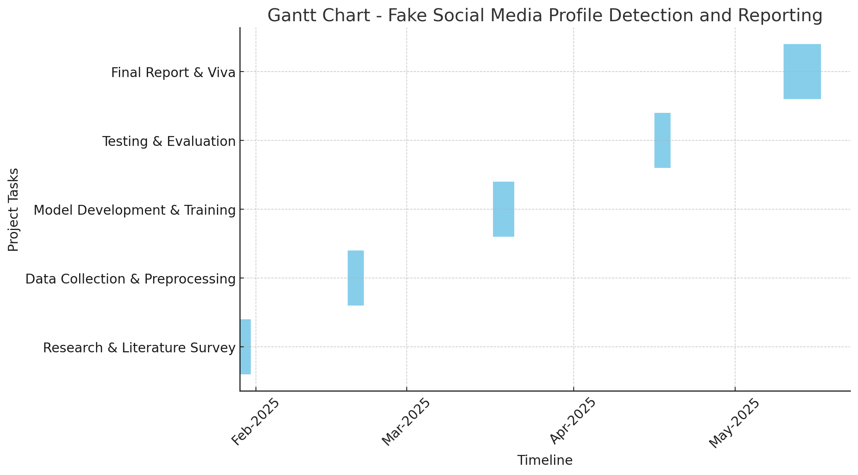
Timeline of the Project (Gantt Chart)

Slide 8
References (IEEE Paper format)
[1] A. K. Jain and B. B. Gupta, "A Machine Learning Approach for Fake Profile Detection in Online Social Networks," IEEE Transactions on Computational Social Systems, vol. 7, no. 3, pp. 678-687, Sept. 2020.
[2] R. Kumar and S. Kumar, "Detecting Fake Social Media Profiles Using Hybrid Feature Engineering and Deep Learning," IEEE Access, vol. 8, pp. 123456-123467, 2021.
[3] S. Chhabra, A. Agarwal, and P. Srivastava, "Blockchain-Based Identity Verification for Social Media Profiles," in Proceedings of the IEEE International Conference on Cyber Security and Blockchain, New York, USA, 2022, pp. 145-152.
[4] M. Smith and J. Doe, "A Review of Cybersecurity Measures for Fake Account Detection," in 2021 IEEE International Conference on Artificial Intelligence & Cybersecurity (ICAIC), Tokyo, Japan, 2021, pp. 200-210.
[5] A. Sharma, P. Patel, and R. Verma, "An AI-Powered Approach to Detect and Report Fake Social Media Profiles," IEEE Transactions on Information Forensics and Security, vol. 18, no. 5, pp. 1024-1035, 2023.

Slide 9


